Slide 1



XTensor 2024: 1st Workshop on Cross-stack Optimization of Tensor Methods Held in conjunction with ASPLOS’24
Organizers:
Jiajia Li @ NCSU, Lizhong Chen @ Oregon State University
Frank Mueller @ NCSU, Dong Li @ UC Merced
Time: 04/27/2024 1:30 – 5:30pm
Location: Grande E

Slide 2
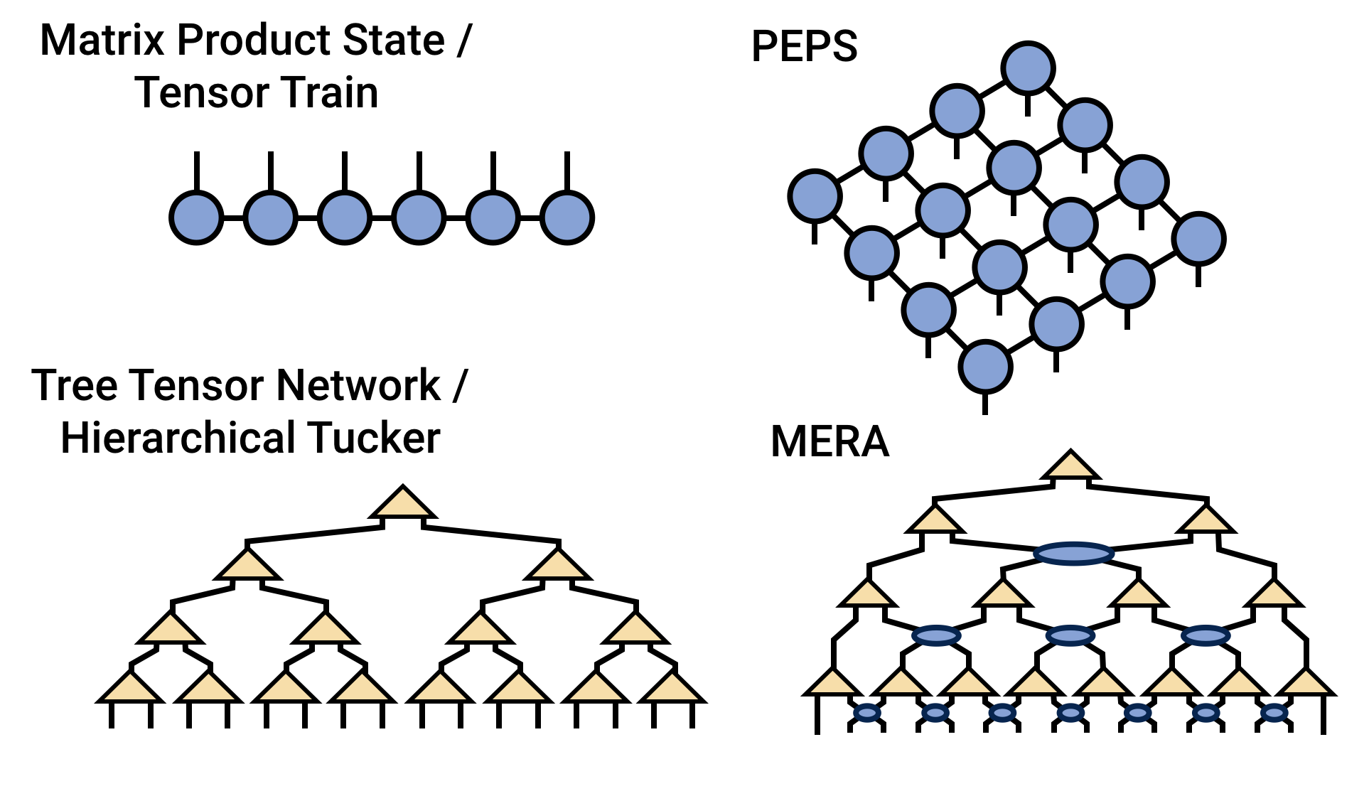
Welcome
This workshop is to communicate state-of-the-art tensor methods from diverse communities:
Architecture/HPC
Programming language
Compiler
Algorithm
etc.
Facilitate discussions on future directions

Slide 3
Agenda
1:30 - 1:40 pm: Welcome and Opening Remarks
1:40 - 2:30 pm: Keynote: “What GPU tensor-cores really bring to the table?” (Ang Li @ PNNL)
2:30 - 2:45 pm: A Novel Sparse Tensor Representation for Quantum Simulations (Srikar Chundury @ NCSU)
2:45 - 3:00 pm: Accelerating GEMV via Targeted Tensor Core Optimizations (Sounder Rajendran @ NCSU)
3:00 - 3:30 pm: Break
3:30 - 4:10 pm: Invited Talk: “Toward Fast and Affordable Serving Systems for Large Language Models” (Xupeng Miao @ CMU)
4:10 - 4:25 pm: Optimizing Sparse Tensor-times-Vector on Cerebras WSE-2 (Sai Krishna Teja Varma Manthena @ NCSU)
4:30 - 5:30 pm: Panel & Open Discussion (Ang Li, Xupeng Miao)

Slide 4
Workshop Website
Talk details are available on the workshop website:
https://fruitfly1026.github.io/static/files/xtensor-asplos24.html
Also linked from ASPLOS’s main website => workshop
Any feedback, comments, suggestions are welcome:
Contact email at the bottom of the workshop website

Slide 5
Postdoc Position
A postdoc position available at NCSU, mentored by Dr. Frank Mueller and Dr. Jiajia Li.
Contact: jiajia.li@ncsu.edu for more details

Slide 6
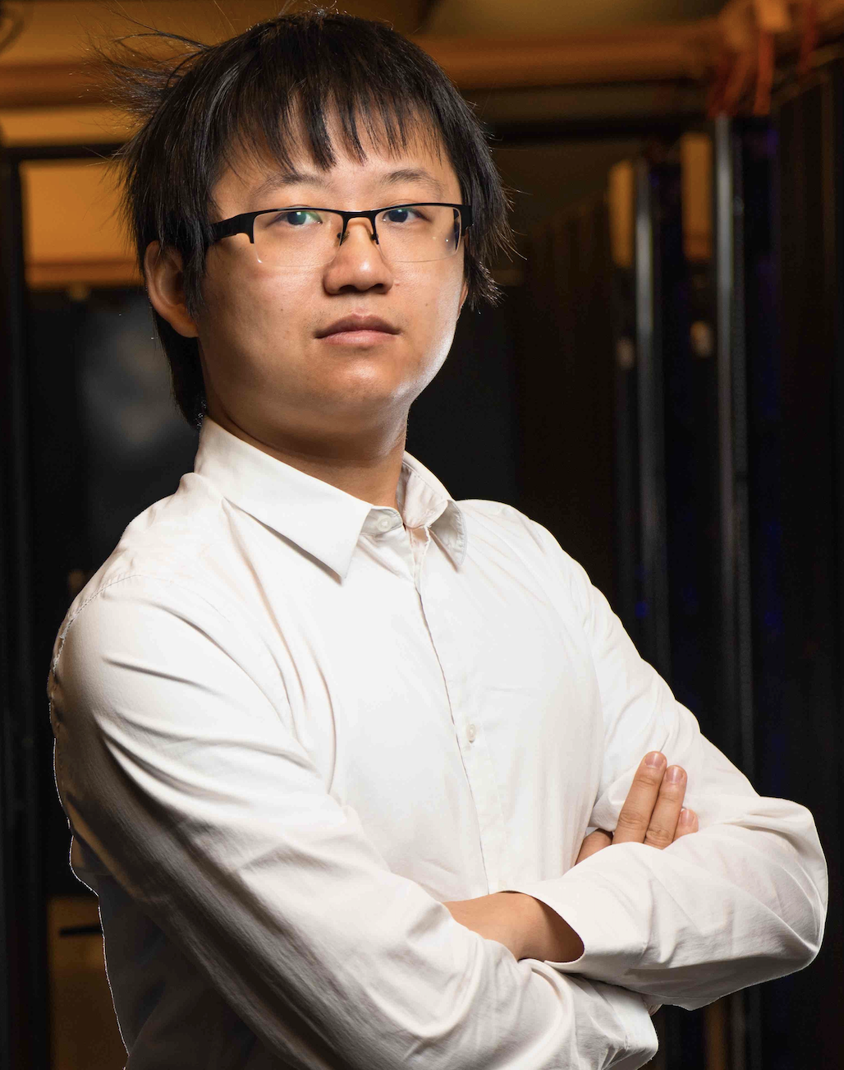
Keynote
Dr. Ang Li
Pacific Northwest National Laboratory
“What GPU tensor-cores really bring to the table?”

